Slide 4


Slide 5


Slide 6
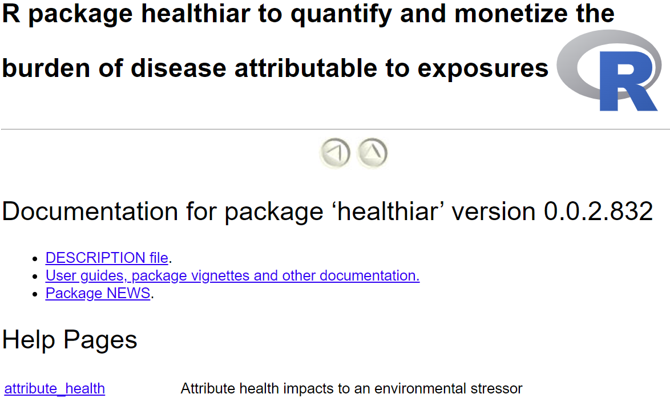
Find here the intro vignette
= Function documentations
…
…

Slide 7
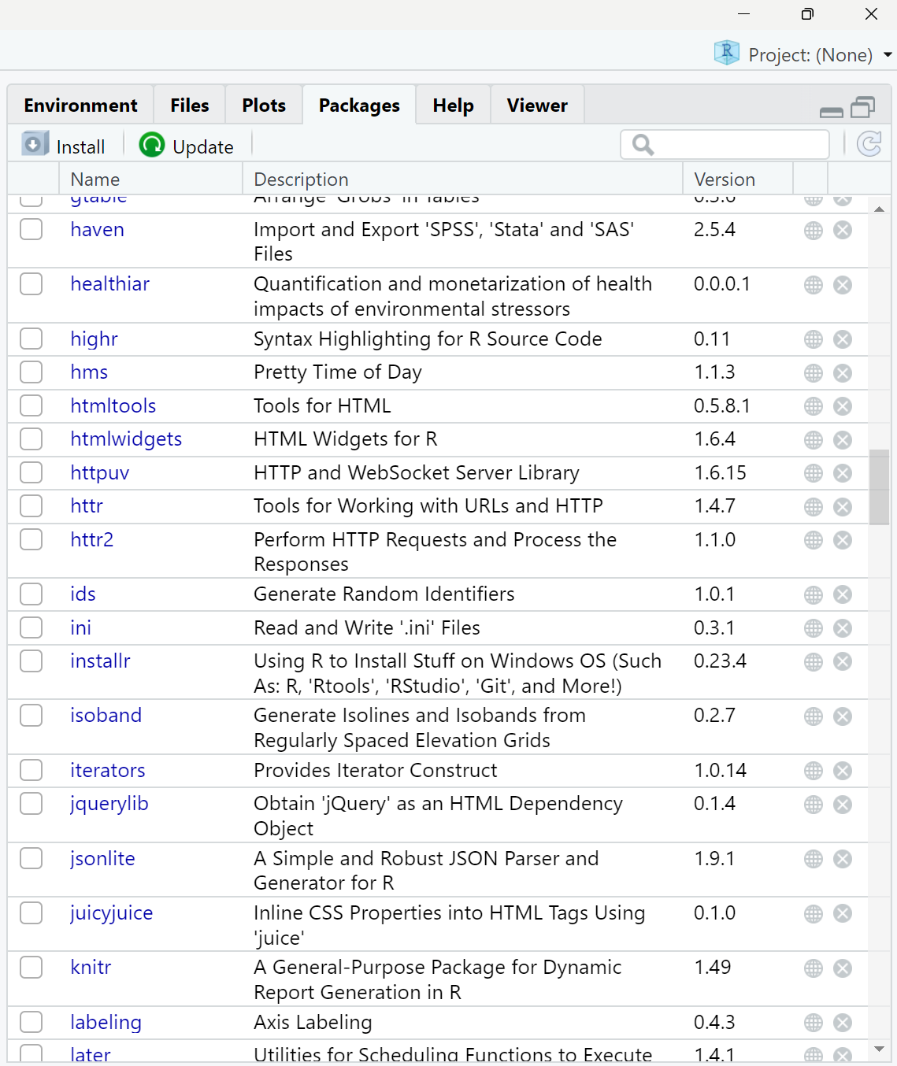
1
2

Slide 8
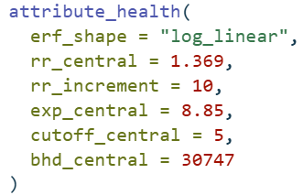
results_pm_copd
function call
function name
function
arguments
argument names
input values

Slide 9
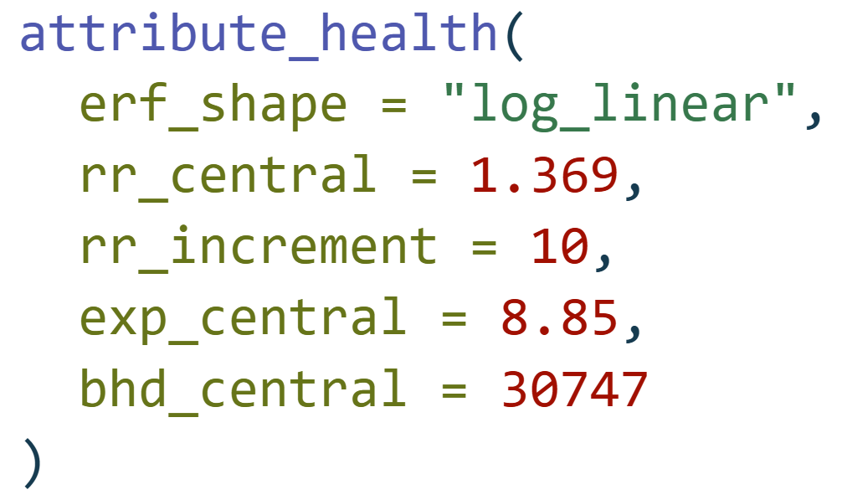
Function call
Function name
attribute_health(
erf_shape = "log_linear",
rr_central = 1.369,
rr_increment = 10,
exp_central = 8.85,
bhd_central = 30747
)
Function arguments
Input values

Slide 10




Exposure response function
Population exposure
Population attributable fraction
Disease-specific burden of disease*
* YLL, YLD, DALY, # deaths, # cases, …
Attributable
burden of disease

Slide 11
Exposure response function
Population exposure
Population attributable fraction
Disease-specific burden of disease*
* YLL, YLD, DALY, # deaths, # cases, …
Attributable
burden of disease

Slide 12
Exposure response function
Population exposure
Population attributable fraction
Disease-specific burden of disease*
* YLL, YLD, DALY, # deaths, # cases, …
Attributable
burden of disease

Slide 13
Exposure response function
Population exposure
Population attributable fraction
Disease-specific burden of disease*
* YLL, YLD, DALY, # deaths, # cases, …
Attributable
burden of disease

Slide 14
Exposure response function
Population exposure
Population attributable fraction
Disease-specific burden of disease*
* YLL, YLD, DALY, # deaths, # cases, …
Attributable
burden of disease

Slide 15
Exposure response function
Population exposure
Attributable
burden of disease

Slide 16
Exposure response function
Population exposure
Attributable
burden of disease

Slide 17
Exposure response function
Population exposure
Attributable
burden of disease

